Slide 1
COVID-19 Data Set
David Godinez

Slide 2
About the Data
-The data was posted by The University of Washington along with The White house, and a few other collaborators
-The purpose of the Data is to make Data Science Specialists help the world gain insights into

Slide 3
Wrangling Techniques
The data was posted as json files so I had to extract the relevant article text from all the other information that came with it.
From here, stopwords and punctutation marks were taken out. The remaining words were also stemmed and lemmatized.
This left a data frame with only meaningful information which was later visualized.

Slide 4
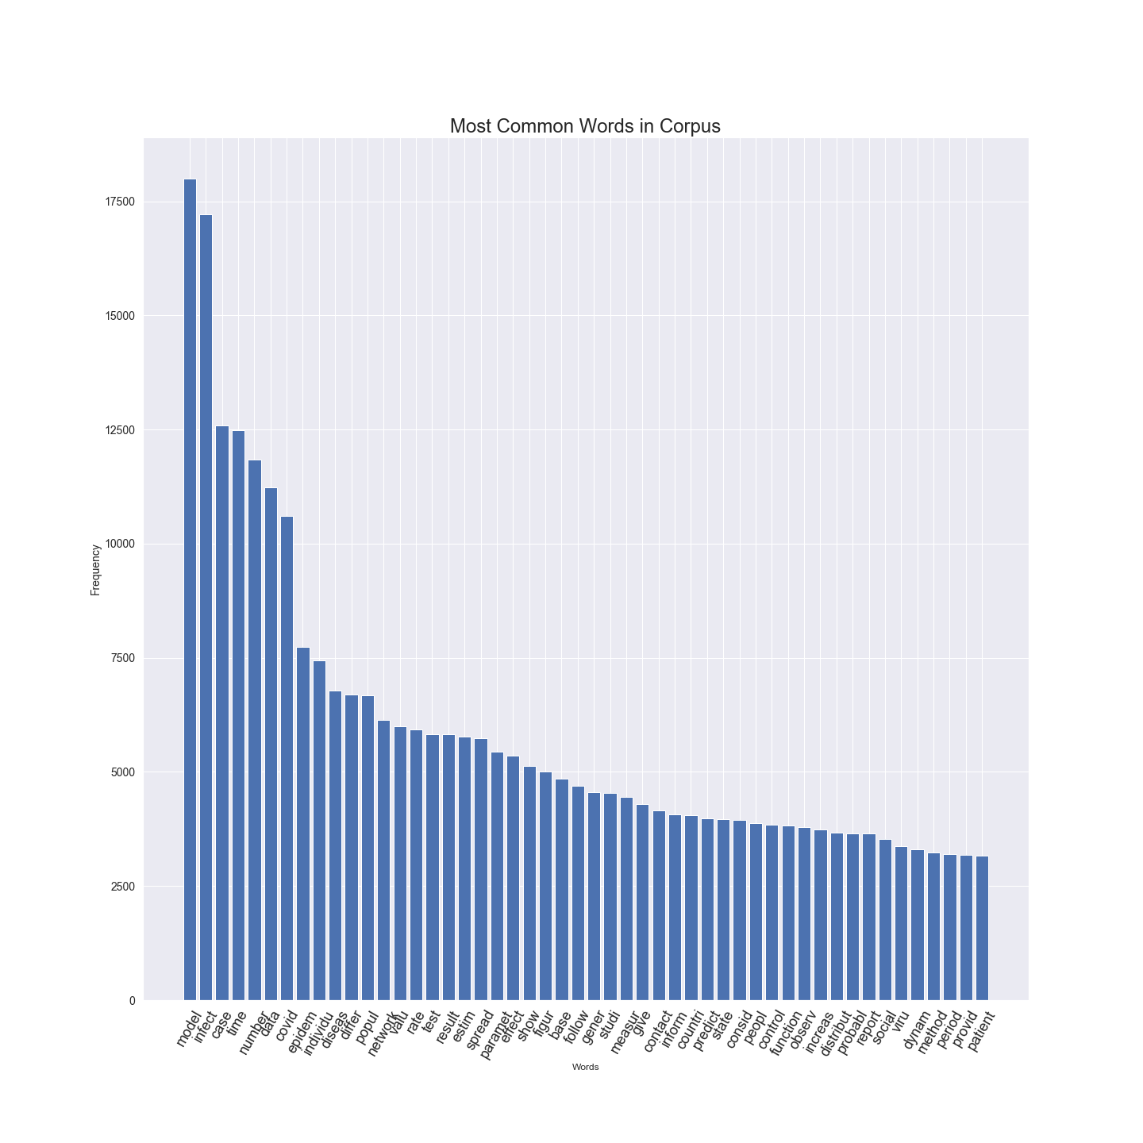
Most Frequent Words Visualization

Slide 5
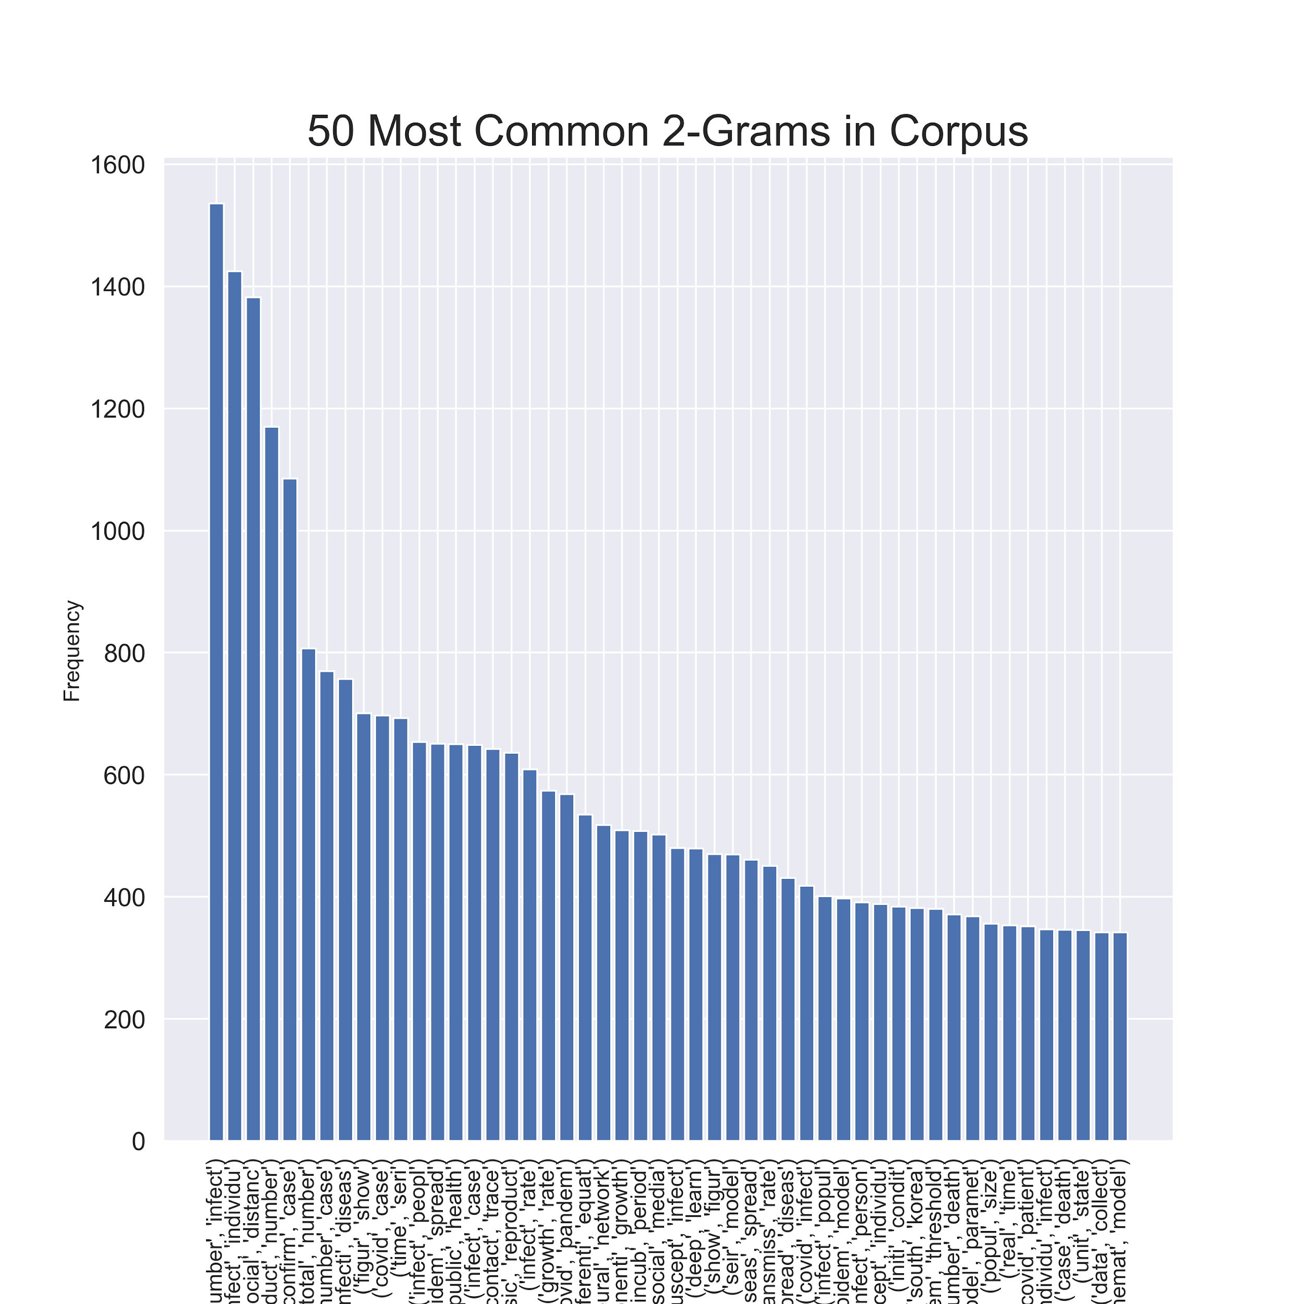
Most Common Words 2-grams Visualization

Slide 6
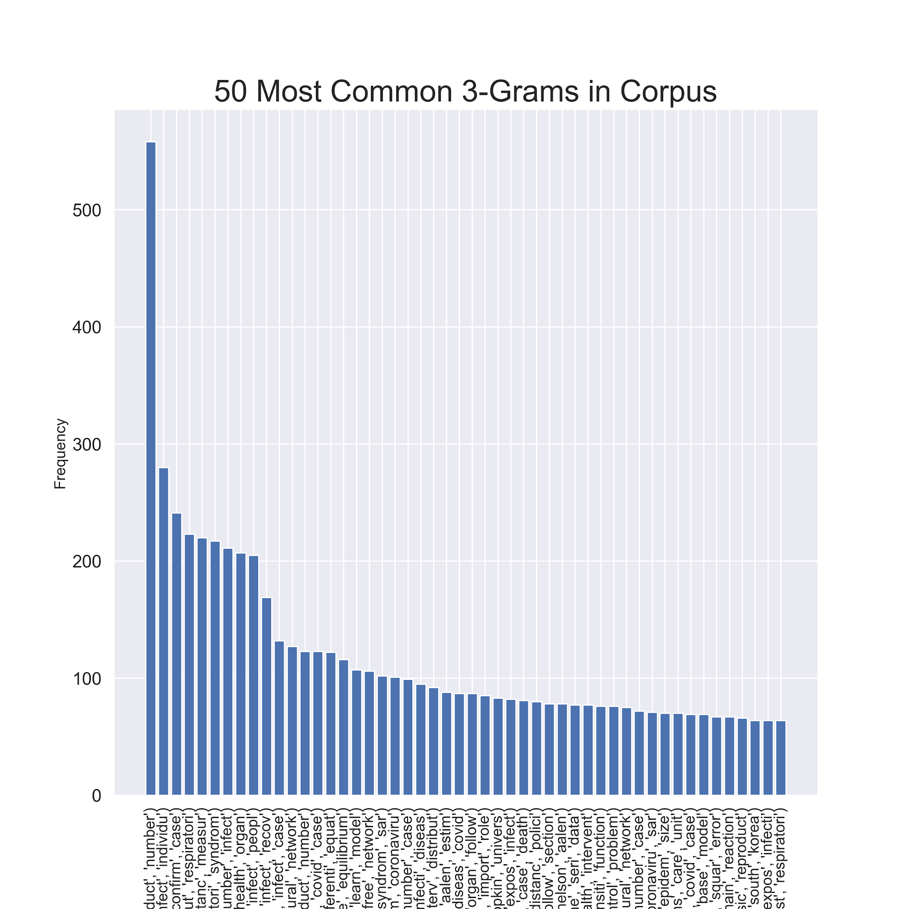
Most Common Words 3-grams Visualization

